Slide 1
Opportunity Hack: National Center for Missing and Exploited Children
Connor Segneri
Joshua Lee
Tommy Fowler
Michael Ryan

Slide 2

The Challenge
The National Center for Missing and Exploited Children (NCMEC) is the only non-profit agency to track child abductions nationwide.
They needed a way to quickly analyze their collected data on missing children and confirmed attempted abductions.

Slide 3
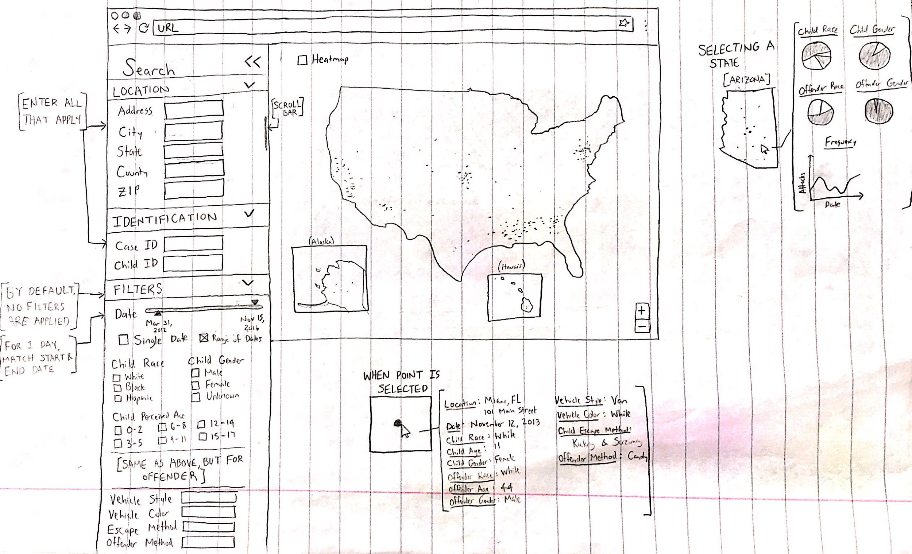
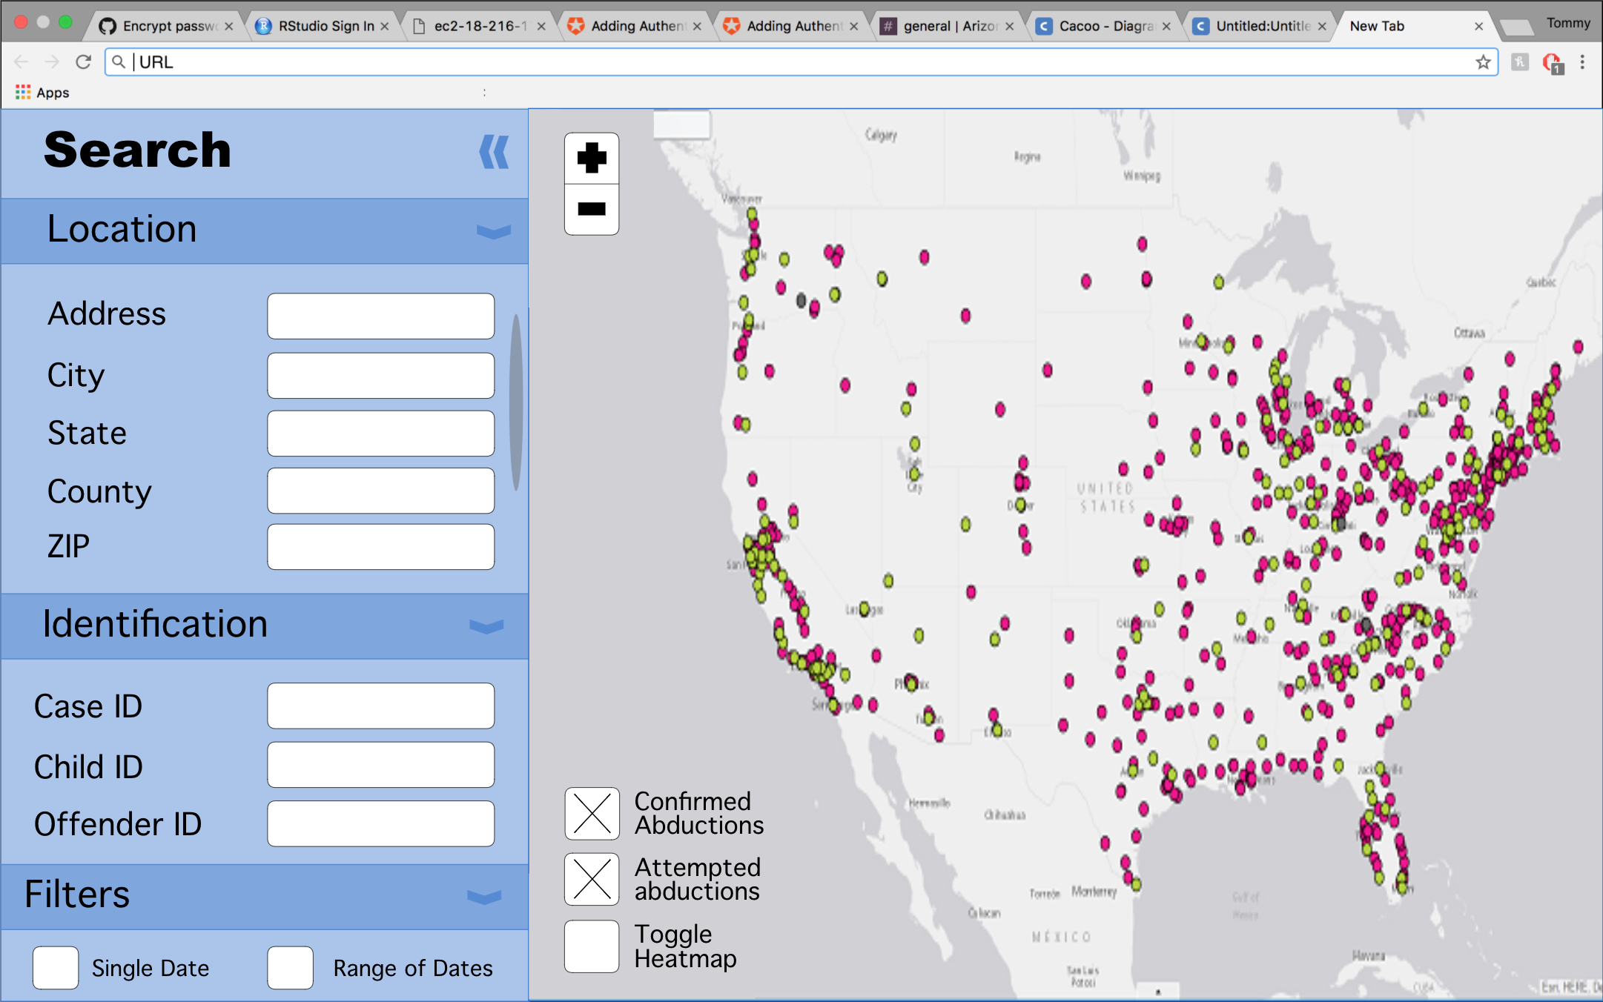
Initial Designs

Slide 4





Tools

Slide 5
Final Product

Slide 6
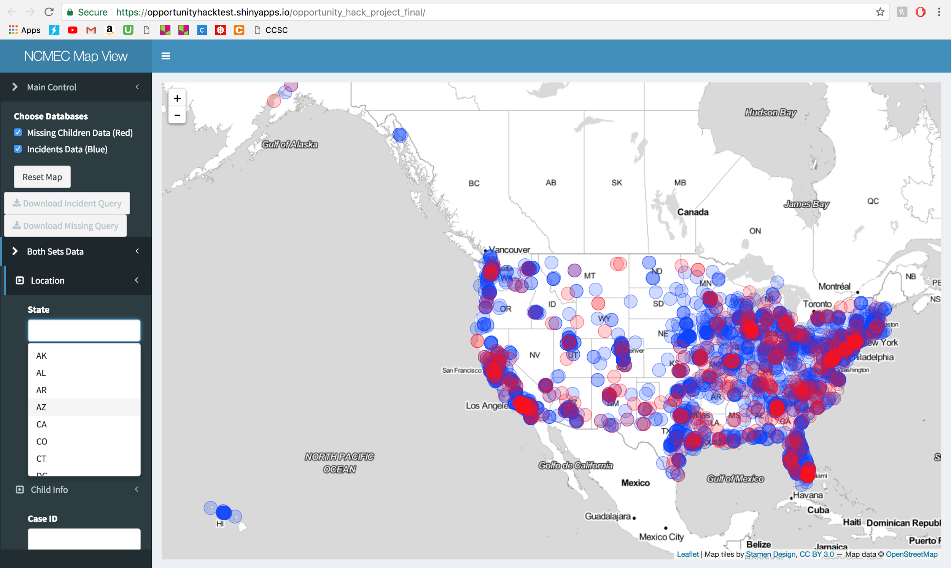

Slide 7
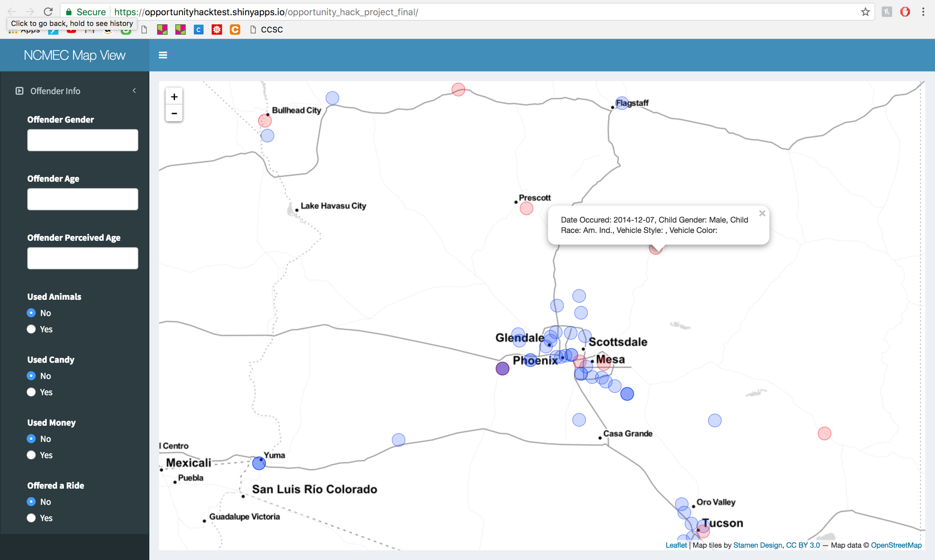

Slide 8
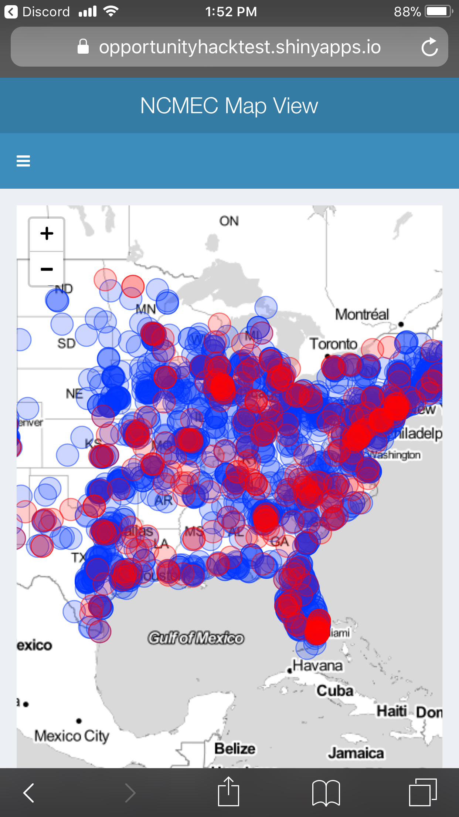
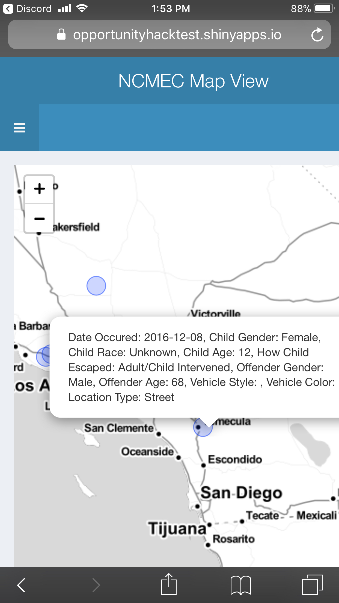

Slide 9
The Project Team

Slide 10

Connor Segneri
Connor Segneri is an Honors student at Grand Canyon University. He will graduate in Spring 2018 with a Bachelor of Science in Computer Science with an emphasis in Big Data Analytics.
Connor is involved in many organizations at Grand Canyon University, including the Honors college and the Innovative Computing (iC) Club.

Slide 11

Joshua Lee
Josh Lee is an Honors student at Grand Canyon University. He will graduate in Spring 2019 with a Bachelor of Science in Computer Science with an emphasis in Big Data Analytics.
Josh is the Marketing Officer of the Innovative Computing (iC) Club. He is also involved in The Project Management Fellowship and the Smart Urban Fabric (SMURF) project, and is working on a mixed reality app for the Microsoft HoloLens.

Slide 12

Thomas Fowler
Tommy Fowler is an Honors student at Grand Canyon University. He will graduate in Spring 2019 with a Bachelor of Science in Computer Science with an emphasis in Big Data Analytics.
Tommy is the Vice President of the Innovative Computing (iC) Club.

Slide 13

Michael Ryan
Michael Ryan a senior at Grand Canyon University. He will be graduating in Spring 2018 with a Bachelor of Science in Information Technology with an emphasis in Cyber Security.
Michael is an active member and past President of the Innovative Computing (iC) Club. He spends his free time volunteering at his church and other organizations.

Slide 14
To the sponsors and non-profits involved: THANK YOU!

